Slide 1

Chapter 14
Entity Authentication
Copyright © The McGraw-Hill Companies, Inc. Permission required for reproduction or display.

Slide 2
Chapter 14
Objectives
To distinguish between message authentication and
entity authentication
To define witnesses used for identification
To discuss some methods of entity authentication
using a password
To introduce some challenge-response protocols for
entity authentication
To introduce some zero-knowledge protocols for
entity authentication
To define biometrics and distinguish between
physiological and behavioral techniques

Slide 3
14-1 INTRODUCTION
Entity authentication is a technique designed to let one party prove the identity of another party. An entity can be a person, a process, a client, or a server. The entity whose identity needs to be proved is called the claimant; the party that tries to prove the identity of the claimant is called the verifier.
Topics discussed in this section:
14.1.1 Data-Origin Versus Entity Authentication
14.1.2 Verification Categories
14.1.3 Entity Authentication and Key Management

Slide 4
14.1.1 Data-Origin Versus Entity Authentication
There are two differences between message authentication (data-origin authentication), discussed in Chapter 13, and entity authentication, discussed in this chapter.
Message authentication might not happen in real time; entity authentication does.
Message authentication simply authenticates one message; the process needs to be repeated for each new message. Entity authentication authenticates the claimant for the entire duration of a session.

Slide 5
14.1.2 Verification Categories
Something known
Something possessed
Something inherent

Slide 6
14.1.3 Entity Authentication and Key Management
This chapter discusses entity authentication. The next chapter discusses key management.

Slide 7
14-2 PASSWORDS
The simplest and oldest method of entity authentication is the password-based authentication, where the password is something that the claimant knows.
Topics discussed in this section:
14.2.1 Fixed Password
14.2.2 One-Time Password

Slide 8
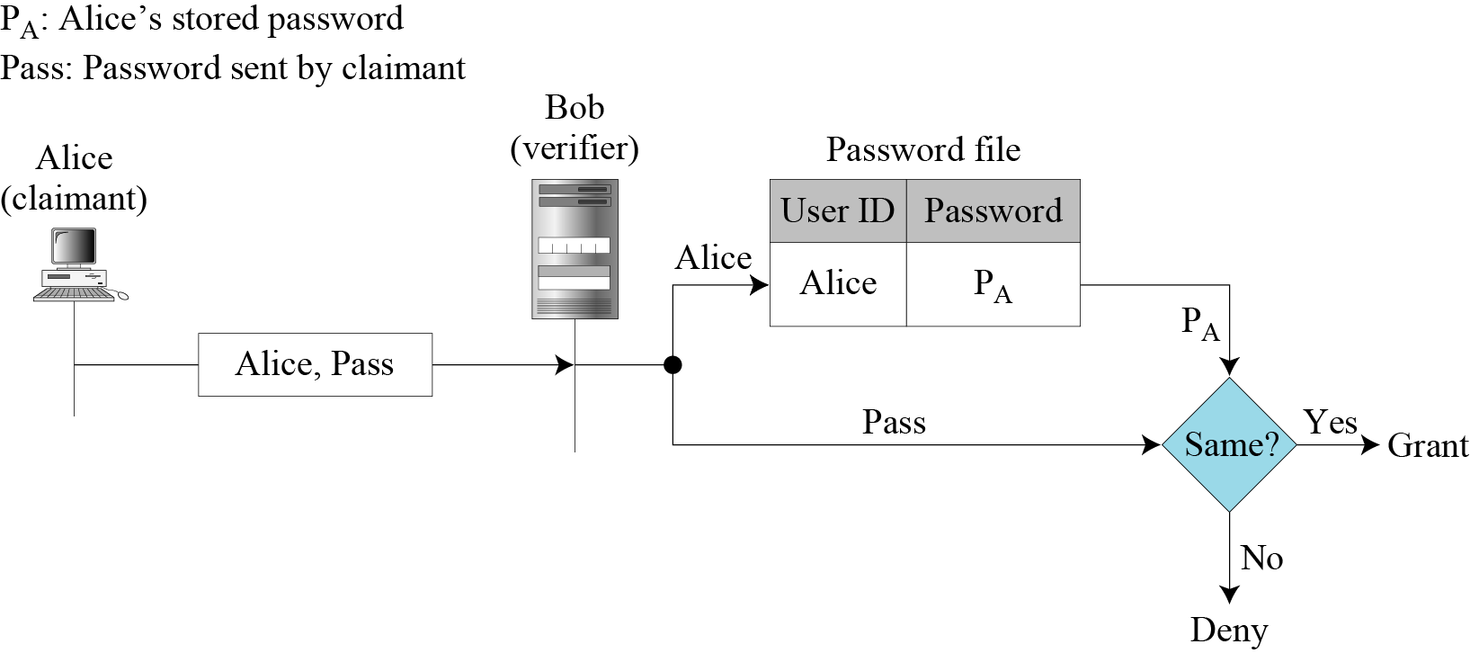
14.2.1 Fixed Password
Figure 14.1 User ID and password file
First Approach
Attacks on the first approach
  Eavesdropping
  Stealing a password
  Accessing a password file
  guessing

Slide 9
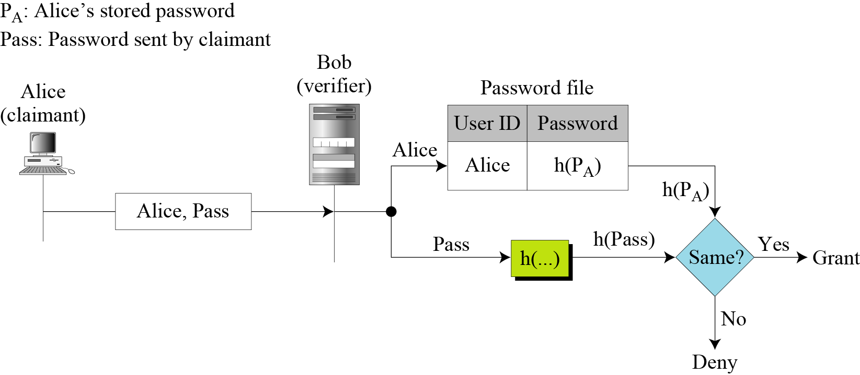
14.2.1 Continued
Second Approach
Figure 14.2 Hashing the password
Dictionary attack
Create a list of password, calculate the hash value, and search the second-column entries to find a match.

Slide 10
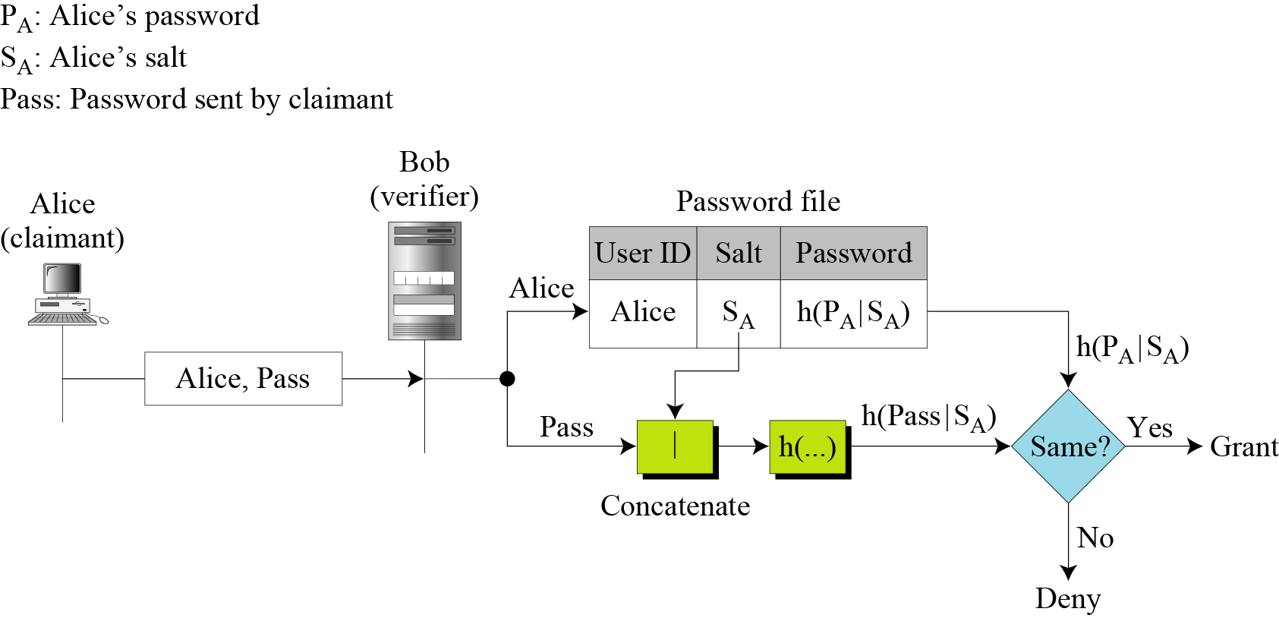
14.2.1 Continued
Third Approach
Figure 14.3 Salting the password
When the password is created, a random string, called the salt, is concatenated to the password. The salted password is then hashed.
The Unix OS uses a variation of this method.

Slide 11
14.2.1 Continued
Fourth Approach
In the fourth approach, two identification techniques are combined.
A good example of this type of authentication is the use of an ATM card (something possessed) with a PIN (personal identification number) (something known).

Slide 12
14.2.2 One-Time Password
A one-time password is a password that is used only once.
In the first approach, the user and the system agree upon a list of passwords.
In the second approach, the user and the system agree to sequentially update the password.
In the third approach, the user and the system create a sequentially updated password using a hash function.

Slide 13
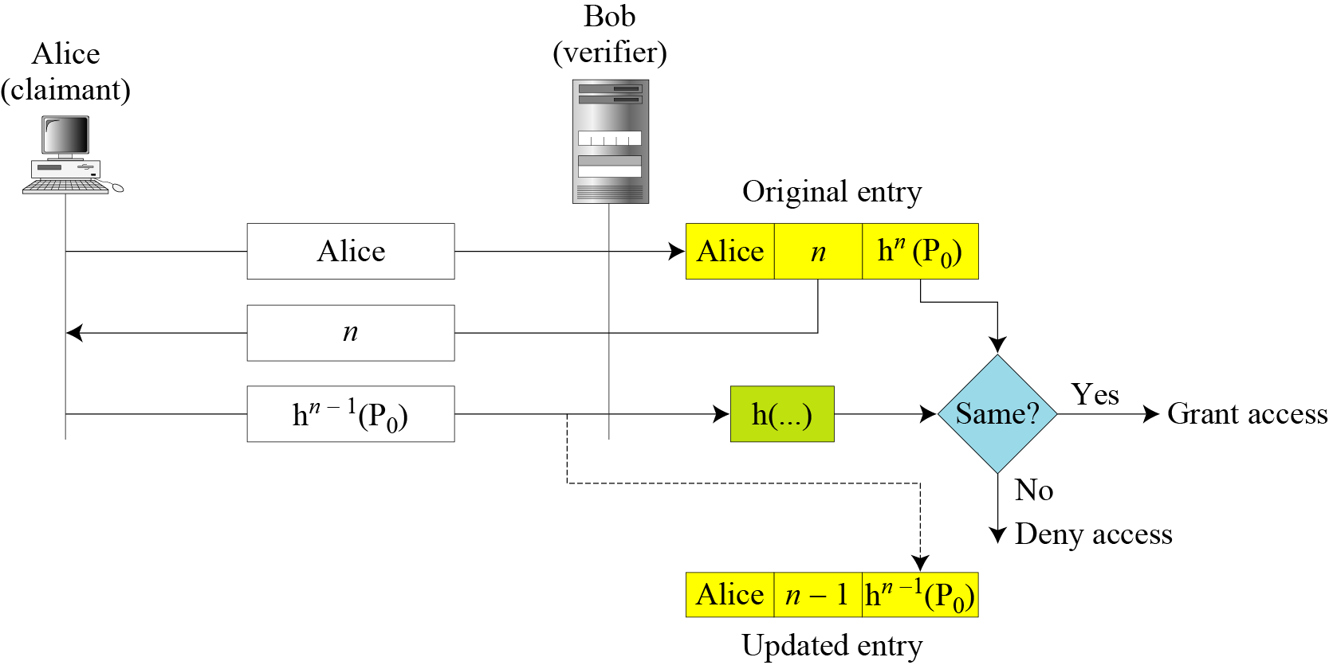
14.2.2 Continued
Figure 14.4 the third approach -- Lamport one-time password
Alice and Bob agree upon an original password P0 and a counter n.
The system stores the identity of Alice, the value of n and the hash.

Slide 14
14-3 CHALLENGE-RESPONSE
In password authentication, the claimant proves her identity by demonstrating that she knows a secret, the password. However, because the claimant reveals this secret, it is susceptible to interception by the adversary. In challenge-response authentication, the claimant proves that she knows a secret without sending it.
Topics discussed in this section:
14.3.1 Using a Symmetric-Key Cipher
14.3.2 Using Keyed-Hash Functions
14.3.3 Using an Asymmetric-Key Cipher
14.3.4 Using Digital Signature

Slide 15

14-3 Continue
Note
In challenge-response authentication, the claimant proves that she knows a secret without sending it to the verifier.
Note
The challenge is a time-varying value sent by the verifier; the response is the result
of a function applied on the challenge.

Slide 16
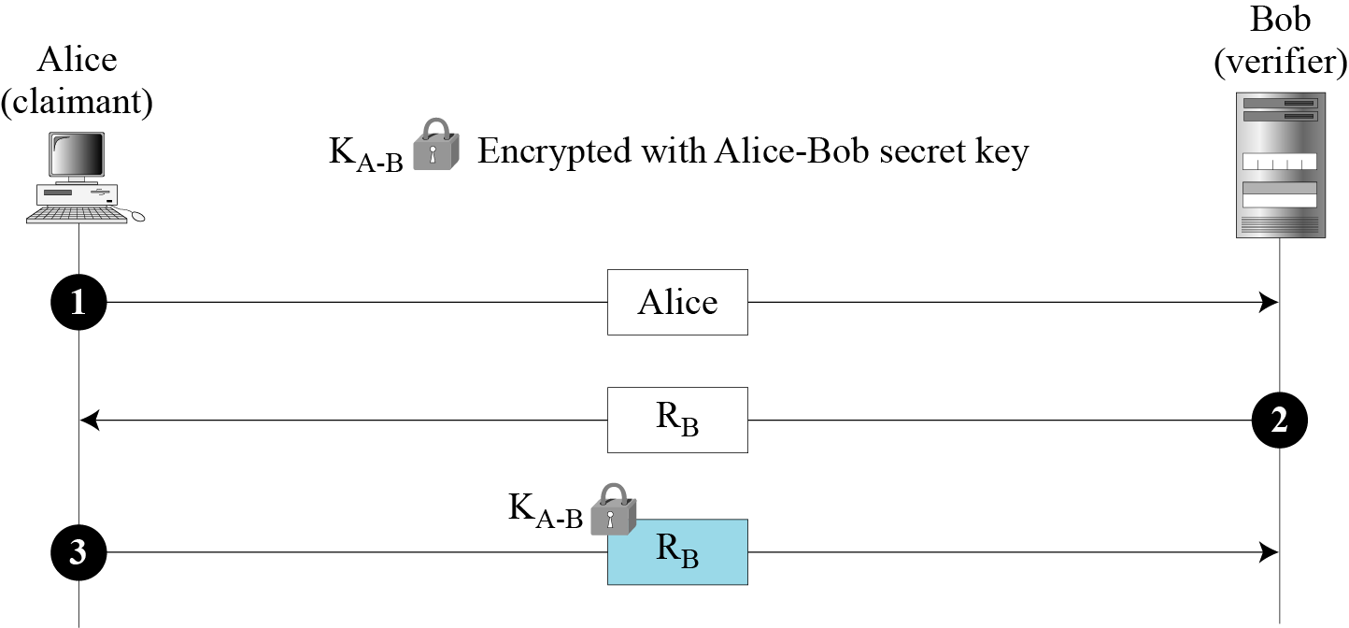
14.3.1 Using a Symmetric-Key Cipher
First Approach
Figure 14.5 Nonce challenge
ID of claimant
The challenge: RB is the nonce randomly chosen by the Bob to challenge Alice
Alice encrypts the nonce using the shared secret key known only to Alice and Bob. Bob decrypts the message. If the nonce obtained from decryption is the same as the one sent by Bob.

Slide 17
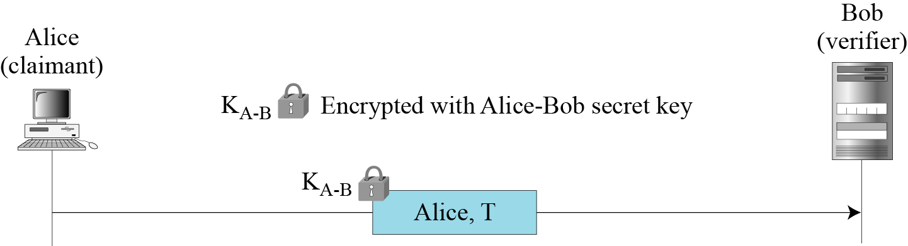
14.3.1 Continued
Figure 14.6 Timestamp challenge
Second Approach
The challenge message is the current time sent from the verifier to the claimant.
The claimant encrypt Alice ID and time with Alice-Bob secret key.

Slide 18
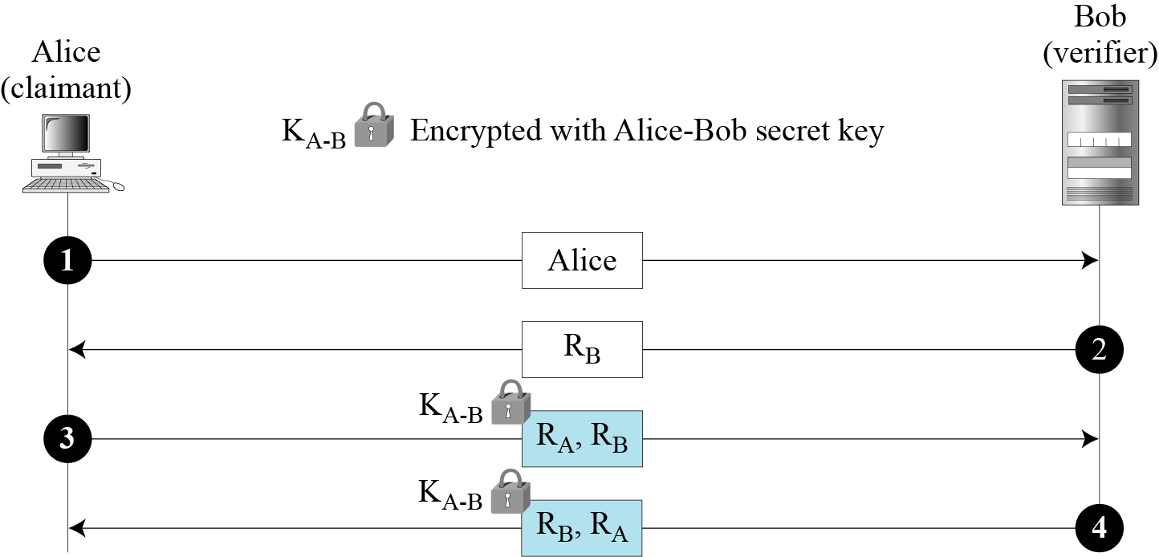
14.3.1 Continued
Third Approach.
Figure 14.7 Bidirectional authentication
Alice ID
The challenge from Bob to Alice RB
Alice respond and send her challenge RA
Bob’s response. RA and RB are switched to prevent a replay attack.

Slide 19
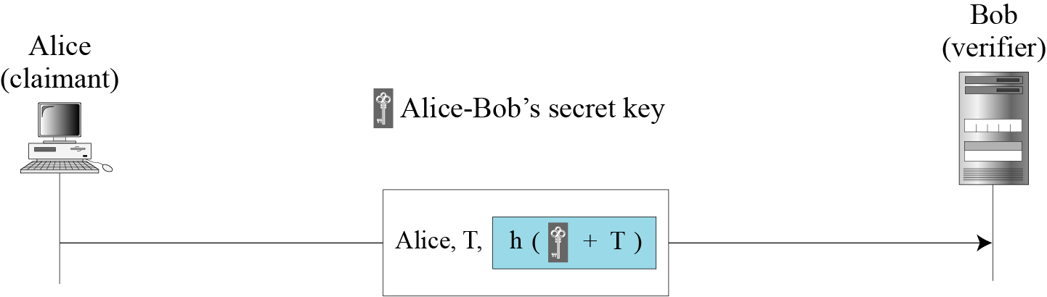
14.3.2 Using Keyed-Hash Functions
Instead of using encryption/decryption for entity authentication, we can also use a keyed-hash function (MAC).
Figure 14.8 Keyed-hash function
The challenge message is the current time sent from the verifier to the claimant.
The timestamp is sent both as plaintext and as text scrambled by the keyed-hash function.
Bob compares his calculation with what he received.

Slide 20
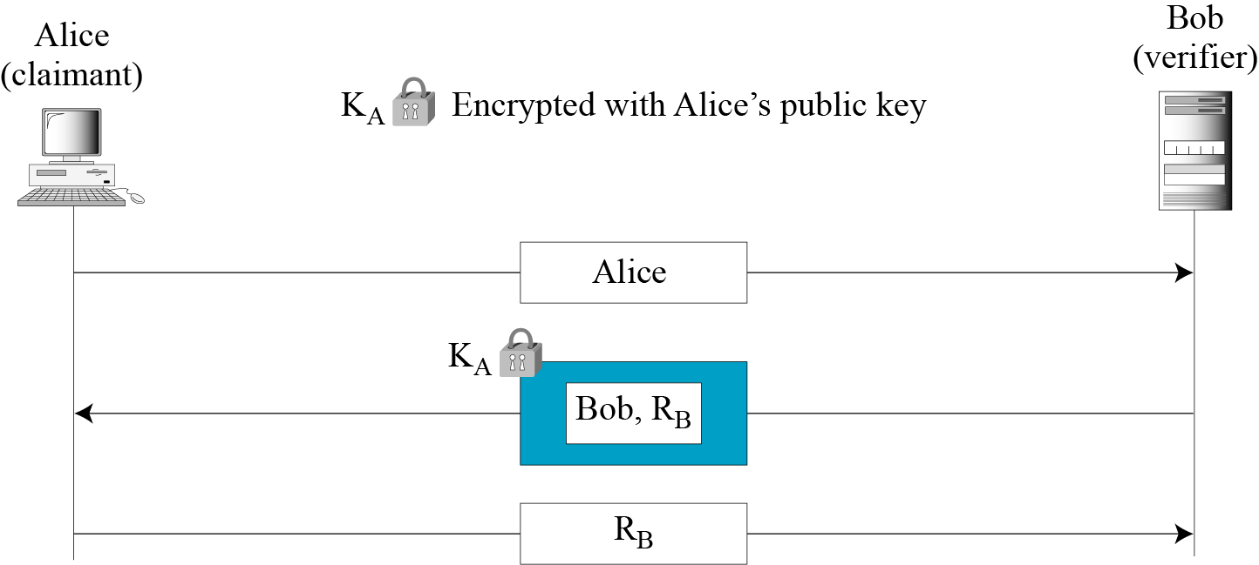
14.3.3 Using an Asymmetric-Key Cipher
First Approach
Figure 14.9 Unidirectional, asymmetric-key authentication
Ownership of claimant’s private key

Slide 21
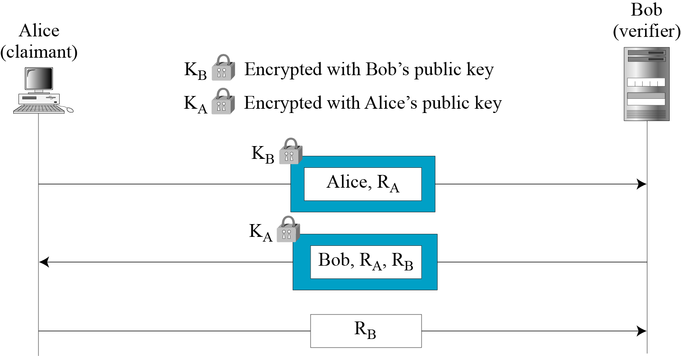
14.3.3 Continued
Second Approach
Figure 14.10 Bidirectional, asymmetric-key

Slide 22
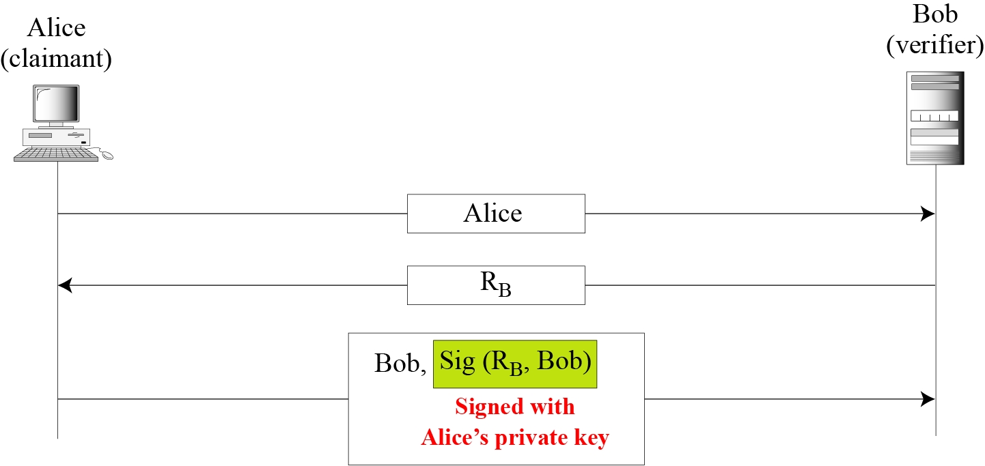
14.3.4 Using Digital Signature
Figure 14.11 Digital signature, unidirectional
First Approach
Ownership of claimant’s private key

Slide 23
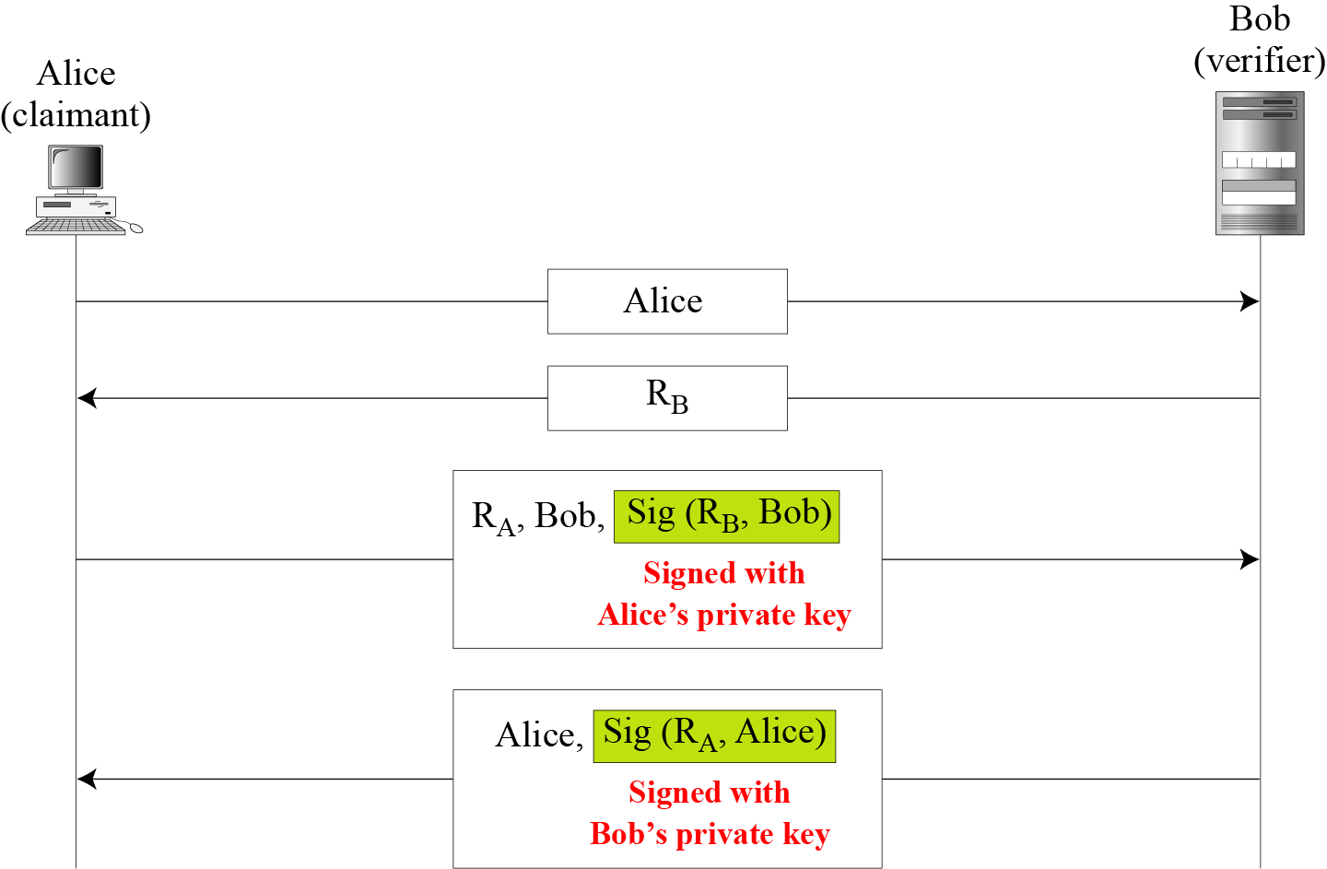
14.3.4 Continued
Second Approach
Figure 14.12 Digital signature, bidirectional authentication

Slide 24
14-4 ZERO-KNOWLEDGE
In zero-knowledge authentication, the claimant does not reveal anything that might endanger the confidentiality of the secret. The claimant proves to the verifier that she knows a secret, without revealing it. The interactions are so designed that they cannot lead to revealing or guessing the secret.
Topics discussed in this section:
14.4.1 Fiat-Shamir Protocol
14.4.2 Feige-Fiat-Shamir Protocol
14.4.3 Guillou-Quisquater Protocol

Slide 25
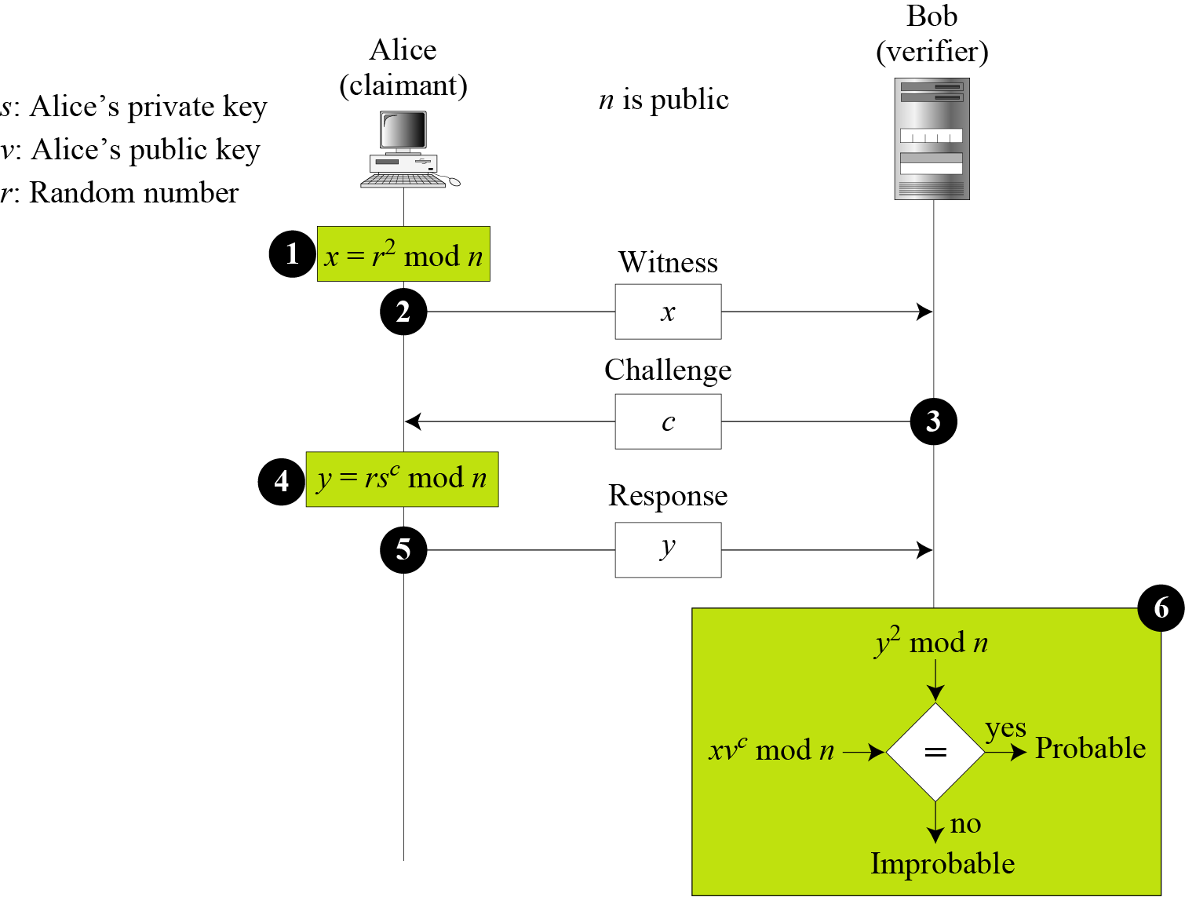


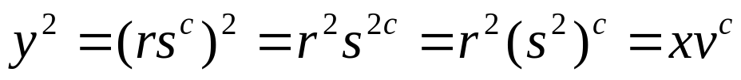
14.4.1 Fiat-Shamir Protocol
Figure 14.13 Fiat-Shamir protocol
is from private key and challenge
is from public key of Alice

Slide 26
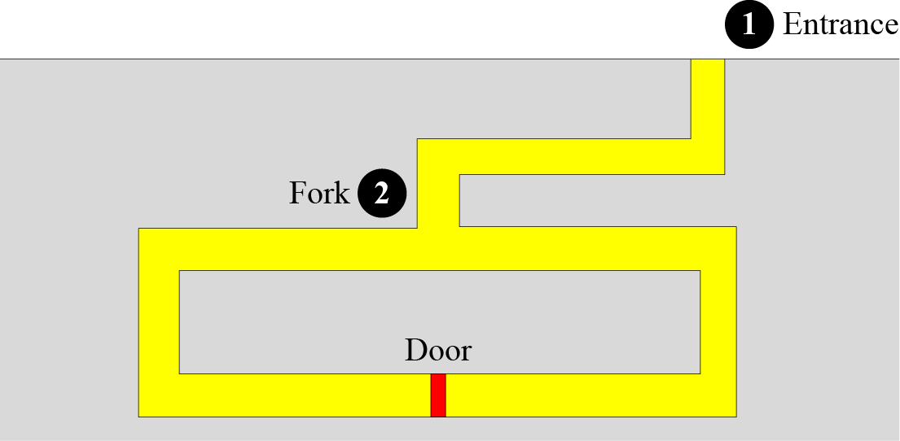
14.4.1 Continued
Cave Example
Figure 14.14 Cave example
The door can only be opened with a magic word. Alice claims that she knows the word and that she can open the door. Bob and Alice are at pint 1. Alice enters eh case and reaches the point 2.
Alice chooses to go either right or left. After Alice disappears, Bob comes to point 2 and asks Alice to come up from either the right or left.
if Alice knows the magic word, she will come up from the right direction. If she does not know the word, she comes up from the right direction with ½ probability.
The game will be repeated many times.

Slide 27
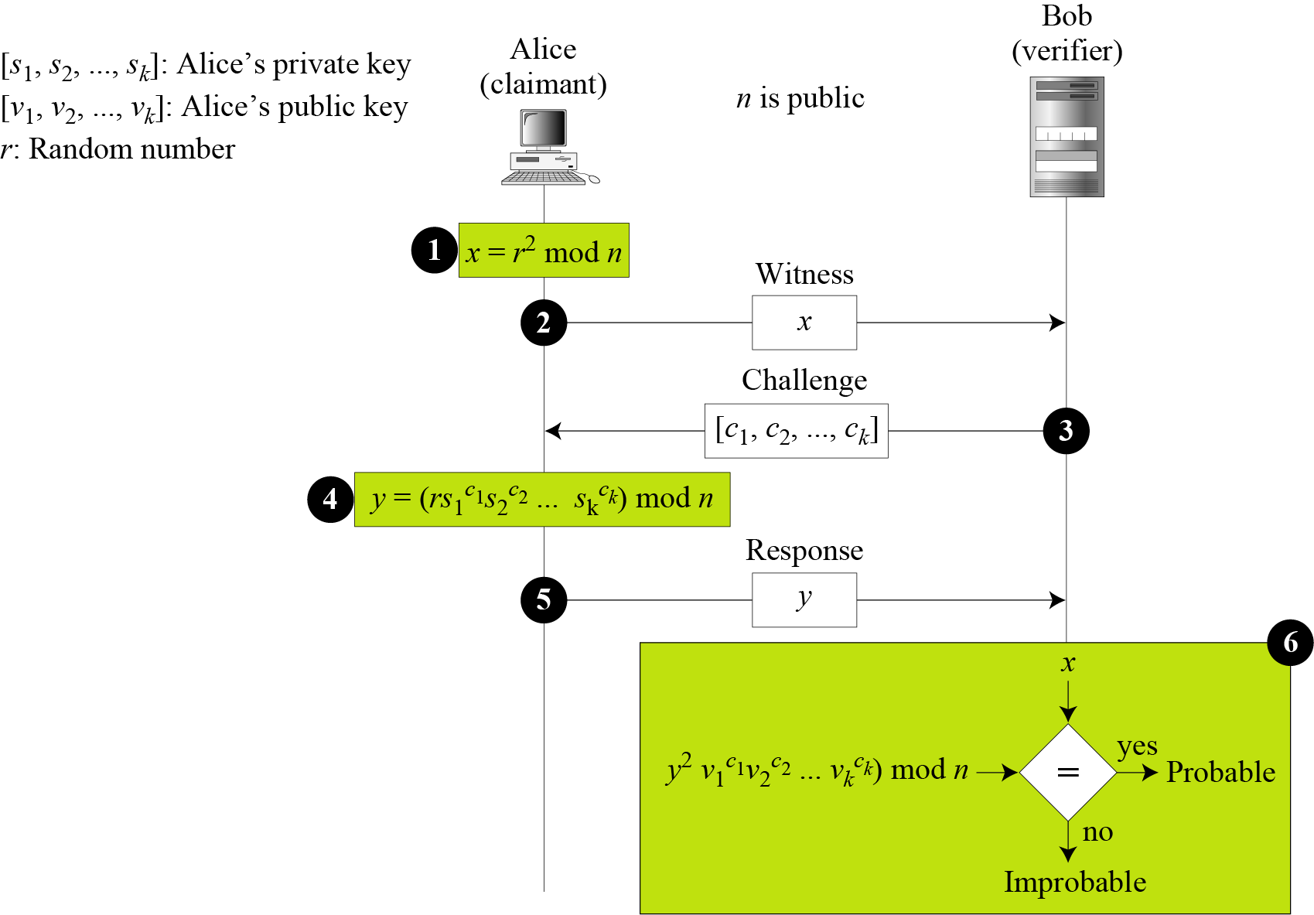
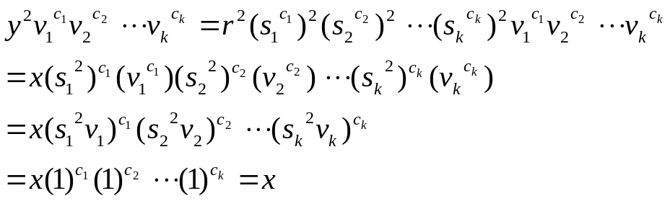
14.4.2 Feige-Fiat-Shamir Protocol
Figure 14.15 Feige-Fiat-Shamir protocol

Slide 28
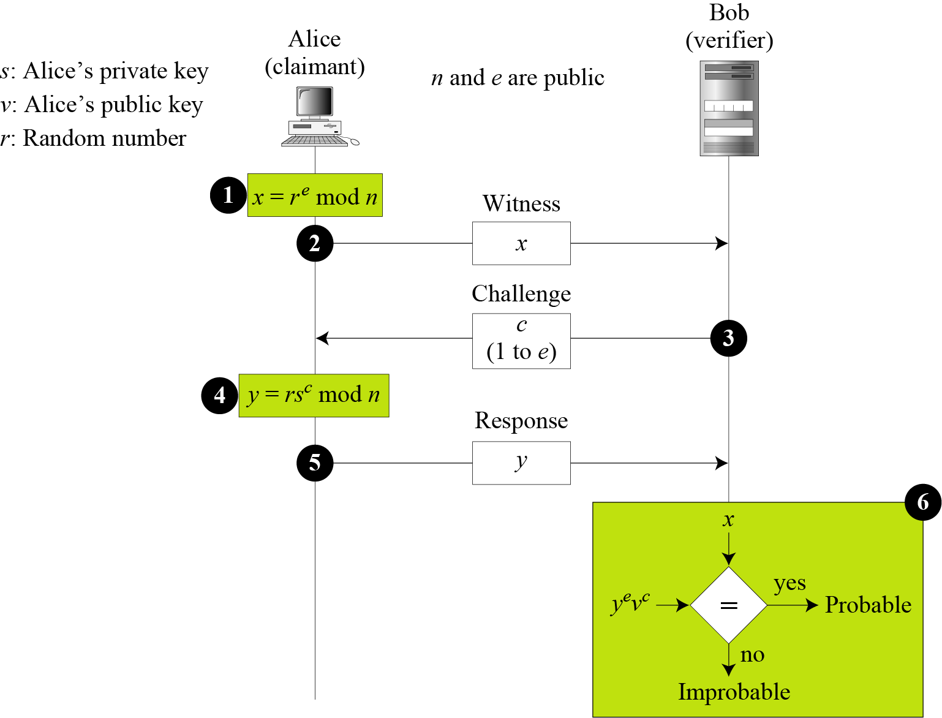
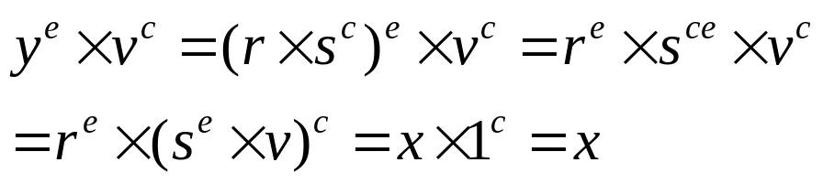
14.4.3 Guillou-Quisquater Protocol
Figure 14.16 Guillou-Quisquater protocol

Slide 29
14-5 BIOMETRICS
Biometrics is the measurement of physiological or behavioral features that identify a person (authentication by something inherent). Biometrics measures features that cannot be guessed, stolen, or shared.
Topics discussed in this section:
14.5.1 Components
14.5.2 Enrollment
14.5.3 Authentication
14.5.4 Techniques
14.5.5 Accuracy
14.5.6 Applications

Slide 30
14.5.1 Components
Several components are needed for biometrics, including capturing devices, processors, and storage devices..

Slide 31
14.5.2 Enrollment
Before using any biometric techniques for authentication, the corresponding feature of each person in the community should be available in the database. This is referred to as enrollment.

Slide 32
14.5.3 Authentication
Verification
Identification

Slide 33
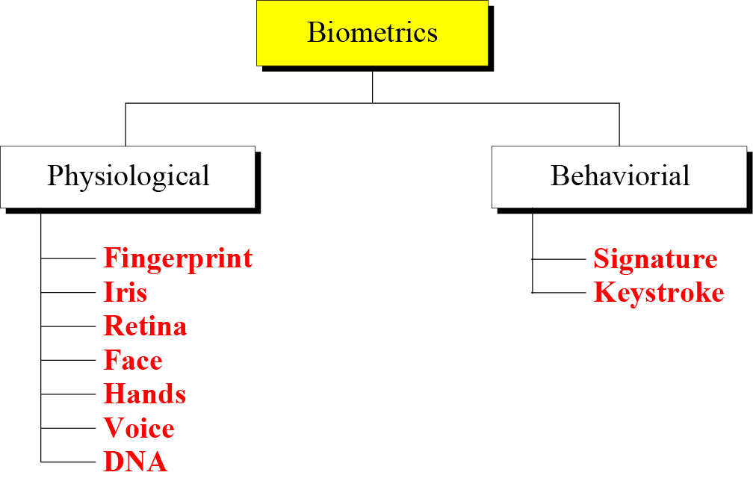
14.5.4 Techniques
Figure 14.17 Techniques

